Slide 1
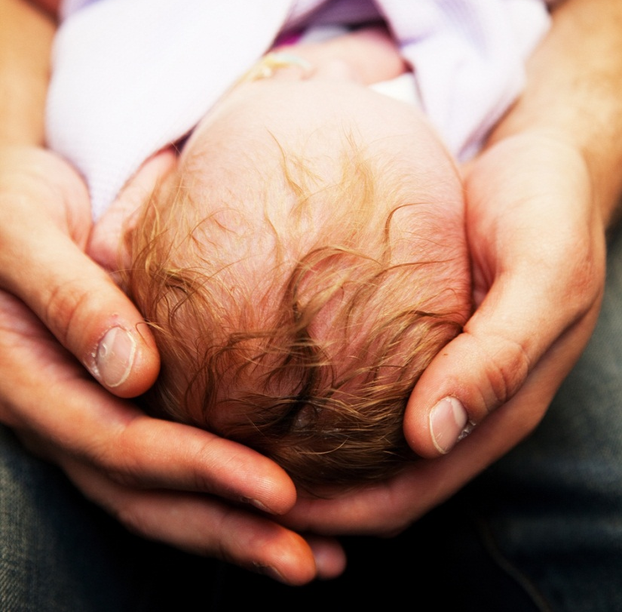
Joint meeting with the Brazelton Centre UK
&
The Cambridge Centre for Perinatal Neuroscience
Saturday, 31st January, 2015
9:30am-4:00pm
Seminar Room 5, Clinical School, Cambridge University Hospitals, NHS Foundation Trust, Cambridge
09:30-09:45am Introductions - Joanna Hawthorne, Ph.D. Director, Brazelton Centre UK and Dr. Topun Austin, CCPN
09:45-10:15 am Research with the NBAS and NBO
Professor Kevin Nugent, Director, Brazelton Institute, Boston
10:15-11:15am Professor Jonathan Hill and Dr. Helen Sharp (Universities of Reading and Liverpool), Dr Susan Pawlby, Institute of Psychiatry, London, Pauline Lee, Clinical Psychologist, Tameside and Glossop
11:15-11:30am Break
11:30am-12:30pm Research at the Cambridge Centre for Perinatal Neuroscience
Dr Topun Austin
?Simon Baron-Cohen (Cambridge Autism Research Centre)
Vicky Leong (Centre for Neuroscience in Education, Cambridge)
Cristine Costa, Cheun Wai Lee
12:30-1:00pm Discussion
1:00pm-1:45pm Lunch
1:45-3:00pm Open Discussion – Study design and analysis
3:00-3:15pm Break
3:15pm- 4:00pm Future ideas for research
4:00pm End of meeting
Topun Austin 07762621292 Joanna Hawthorne 07774290599
The Brazelton Centre UK
Registered charity number: 1158765
www.brazelton.co.uk e-mail: info@brazelton.co.uk

